Slide 1
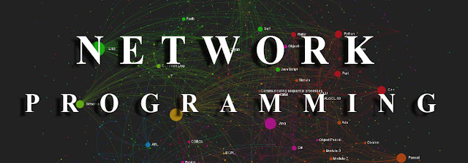


IT432 - Network Programming
Dr. Ali Hussein Ahmed
Ali.Hussein@aun.edu.eg
IT Dept - office no. 312
2022

Slide 2

Lecture 5
Asynchronous Sockets

Slide 3
The blocking socket mode
Sockets in blocking mode will wait forever to complete their functions, holding up other functions within the application program until they complete.
Many programs can work quite efficiently in this mode, but for applications that work in the Windows programming environment, this can be a problem.
Asynchronous Socket methods allow a network program to continue rather than waiting for a network operation to be performed.
Guess which is best?

Slide 4
Just as events can trigger delegates, .NET also provides a way for methods to trigger delegates.
A delegate defines the method to be called once an event occurred.
checkit.Click += new EventHandler(ButtonOnClick);
When the customer clicks the button, the program control moves to the ButtonOnClick() method:
void ButtonOnClick(object obj, EventArgs ea)
{
results.Items.Add(data.Text);
data.Clear();
}

Slide 5
Async Callback Class
The .NET AsyncCallback class allows methods to start an asynchronous function and supply a delegate method to call when the asynchronous function completes.
The Socket class utilizes the method defined in the AsyncCallback to allow network functions to operate asynchronously in background processing.
It signals the OS when the network functions have completed and passes program control to the AsyncCallback method to finish the network function.

Slide 6
The Socket asynchronous methods split common network programming functions into two pieces:
A Begin method that starts the network function and registers the AsyncCallback method
An End method that completes the function when the AsyncCallback method is called

Slide 7
.Net asynchronous Socket methods
Requests Started By… | Description of Request | Requests Ended BY…
BeginAccept() | To accept an incoming connection | EndAccept()
BeginConnect() | To connect to a remote host | EndConnect()
BeginReceive() | To retrieve data from a socket | EndReceive()
BeginReceiveFrom() | To retrieve data from a specific remote host | EndReceiveFrom()
BeginSend() | To send data from a socket | EndSend()
BeginSendTo() | To send data to a specific remote host | EndSendTo()

Slide 8
The BeginAccept() and EndAccept() Methods
Socket sock = new Socket(AddressFamily.InterNetwork, SocketType.Stream,
ProtocolType.Tcp);
IPEndPoint iep = new IPEndPoint(IPAddress.Any, 9050);
sock.Bind(iep);
sock.Listen(5);
sock.BeginAccept(new AsyncCallback(CallAccept), sock);
private static void CallAccept(IAsyncResult iar)
{
Socket server = (Socket)iar.AsyncState;
Socket client = server.EndAccept(iar);
}

Slide 9
The BeginConnect() and EndConnect() Methods
Socket newsock = new Socket(AddressFamily.InterNetwork, SocketType.Stream,
ProtocolType.Tcp);
IPEndPoint iep = new IPEndPoint(IPAddress.Parse("127.0.0.1"), 9050);
newsock.BeginConnect(iep, new AsyncCallback(Connected), newsock);
public static void Connected(IAsyncResult iar)
{
Socket sock = (Socket)iar.AsyncState;
try
{
sock.EndConnect(iar);
}
catch (SocketException)
{
Console.WriteLine("Unable to connect to host");
}
}

Slide 10
Sending and Receiving Data
sock.BeginSend(data, 0, data.Length, SocketFlags.None,
new AsyncCallback(SendData), sock);
private static void SendData(IAsyncResult iar)
{
Socket server = (Socket)iar.AsyncState;
int sent = server.EndSend(iar);
}

Slide 11
Other Asynch calls
The BeginSendTo() and EndSendTo() Methods
The BeginReceive() and EndReceive() Methods
The BeginReceiveFrom() and EndReceiveFrom() Methods

Slide 12
Example
In the next few slides, we will create a windows application for both clint and server.
We will notice that our GUI did not freeze during the blocking socket calls.

Slide 13
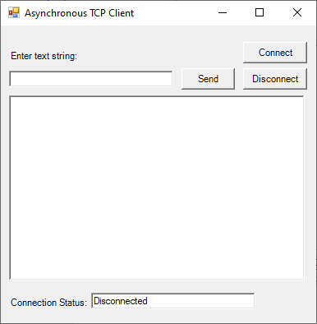
The Client Program

Slide 14
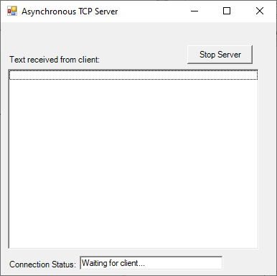
The server Program

Slide 15
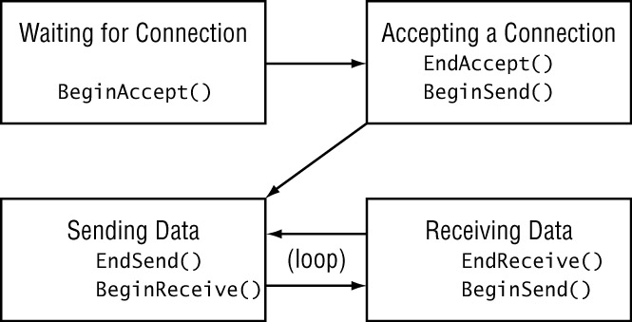
The server loop

Slide 16
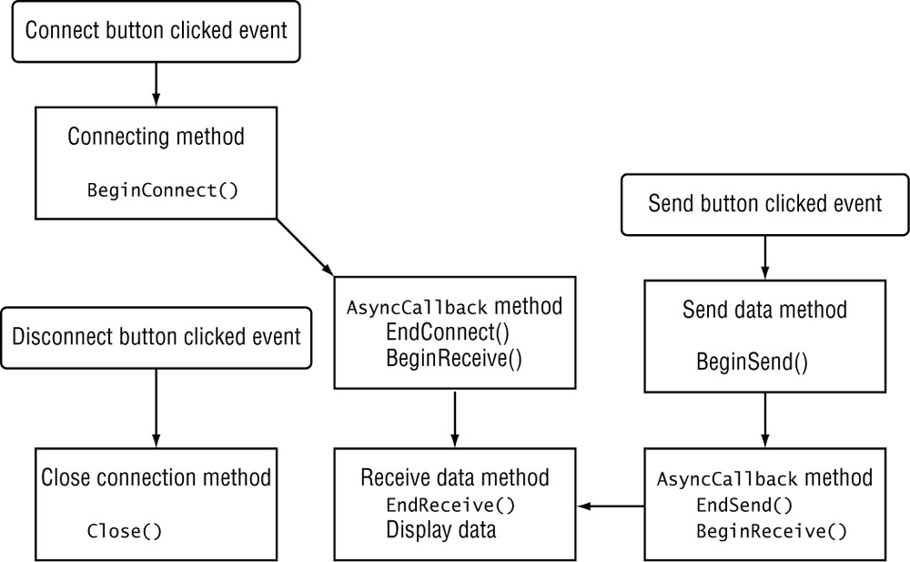
The client

Slide 17
The source code
Client.cs
Server.cs

Slide 18
Next topic
Multithreaded server

